Slide 1
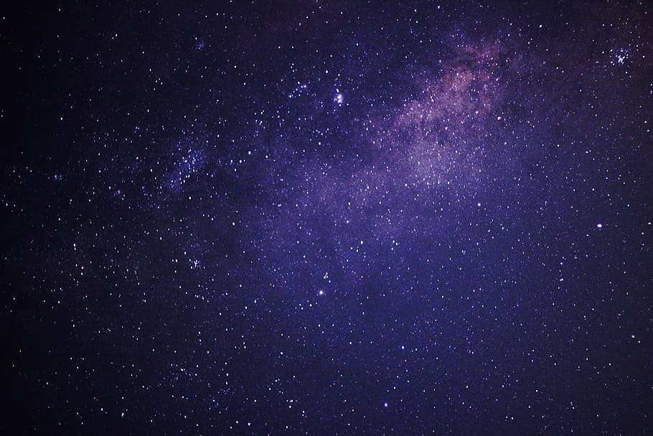
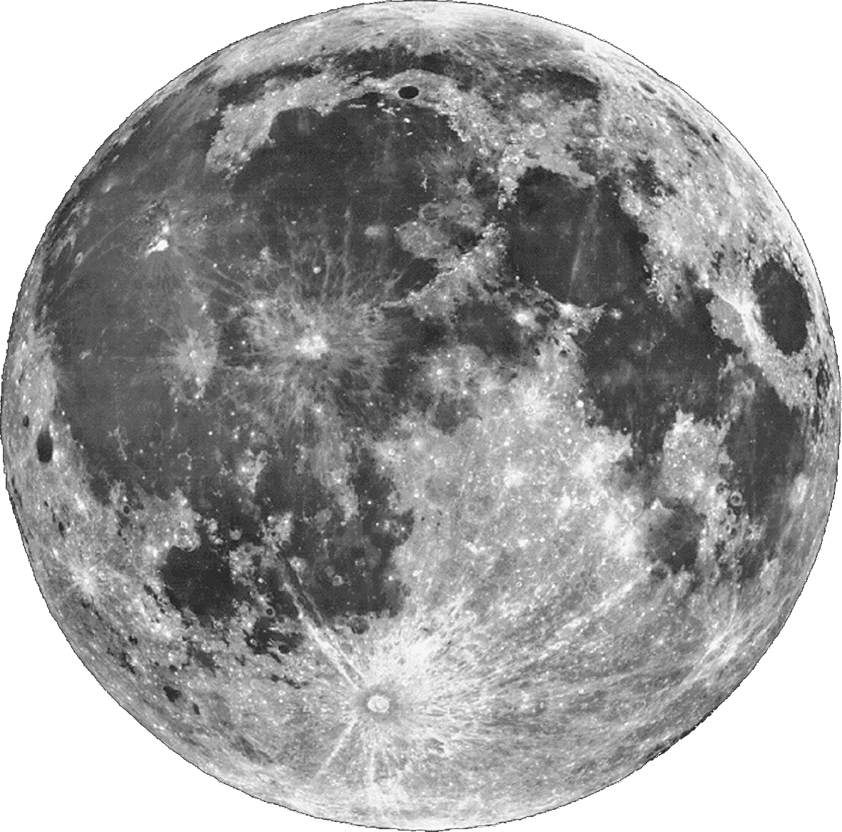
THE MOON
THE MOON
THE MOON
THE MOON
THE MOON

Slide 2
THE MOON
THE MOON
THE MOON
THE MOON
THE MOON
The Moon is Earth’s only natural satellite. It orbits at an average distance of 384400 km, about 30 times the planet’s diameter. The Moon always presents the same side to Earth, because gravitational pull has locked its rotation to the planet. This results in the lunar day of 29.5 days matching the lunar month.

Slide 3
THE MOON
THE MOON
THE MOON
THE MOON
The Moon is Earth’s only natural satellite. It orbits at an average distance of 384400 km, about 30 times the planet’s diameter. The Moon always presents the same side to Earth, because gravitational pull has locked its rotation to the planet. This results in the lunar day of 29.5 days matching the lunar month.
THE MOON

